Slide 1


Slide 2


Slide 3


Slide 4
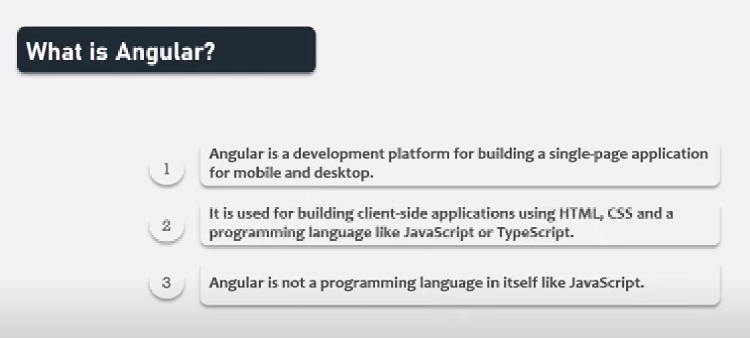

Slide 5


Slide 6


Slide 7


Slide 8


Slide 9


Slide 10
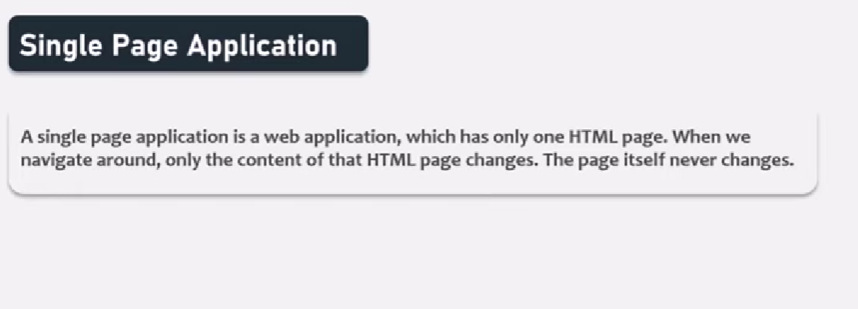

Slide 11
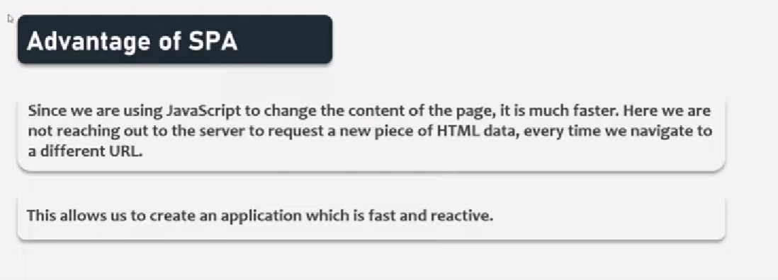

Slide 12
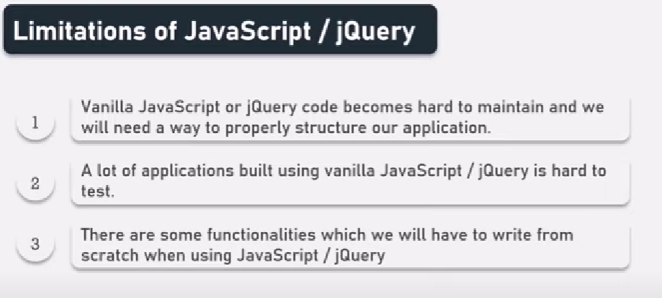

Slide 13


Slide 14
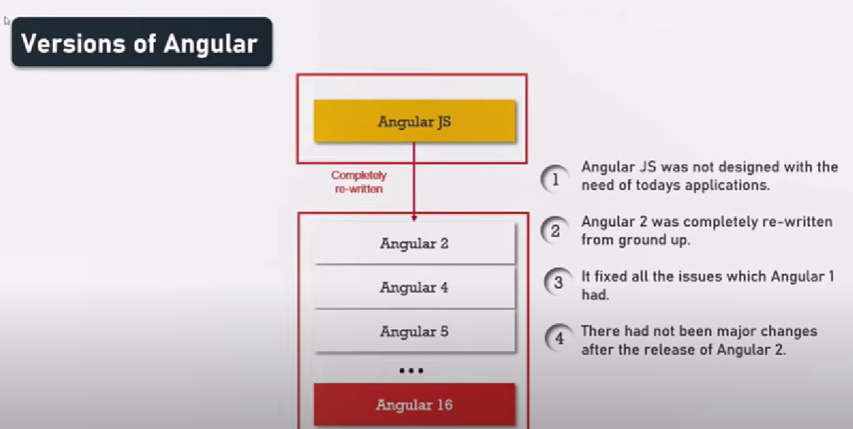

Slide 15


Slide 16
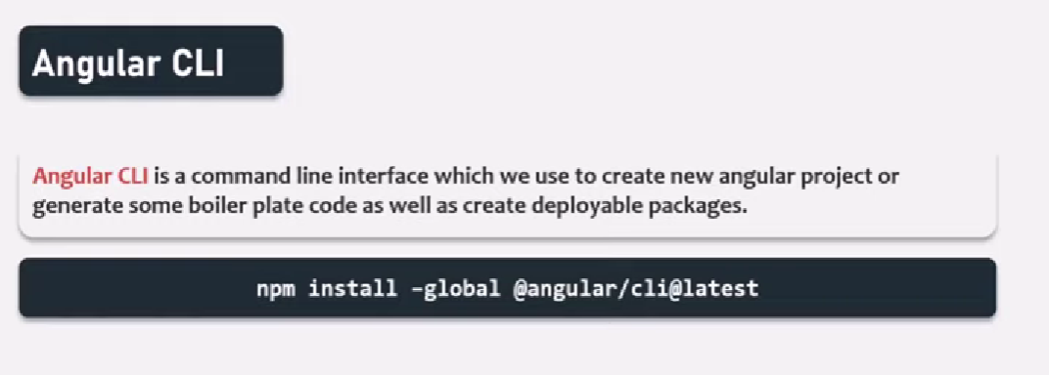

Slide 17
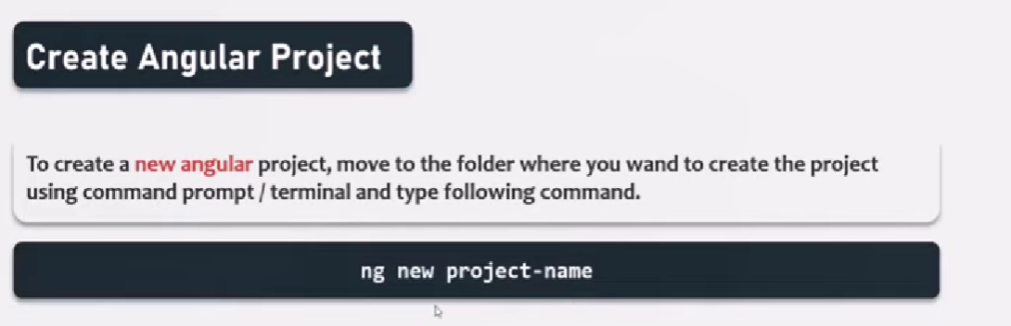

Slide 18
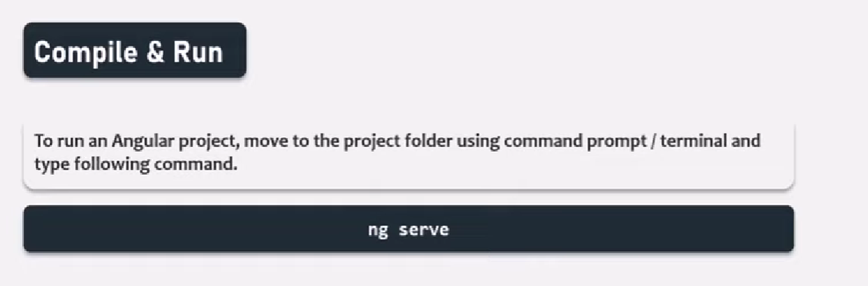

Slide 19


Slide 20


Slide 21






Slide 22

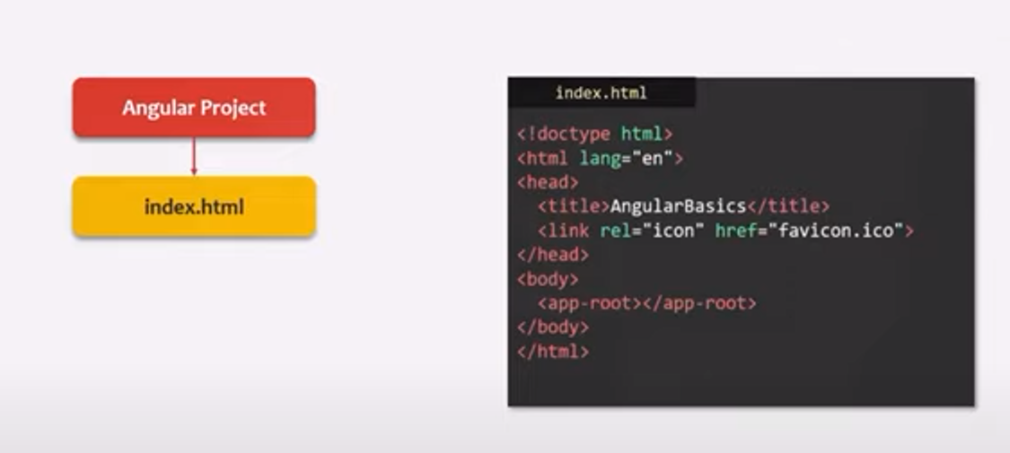
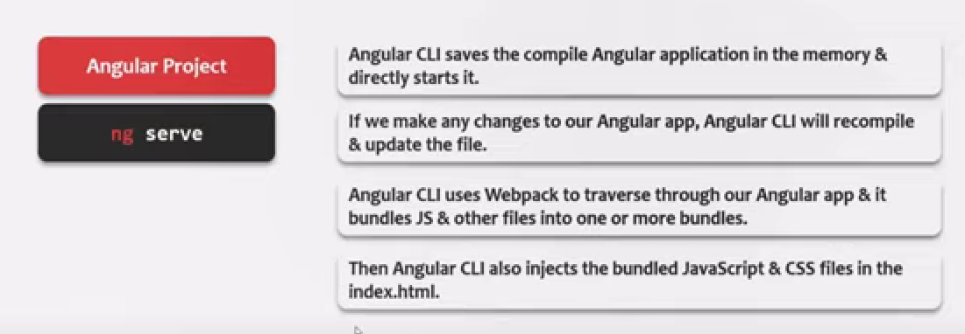

Slide 23
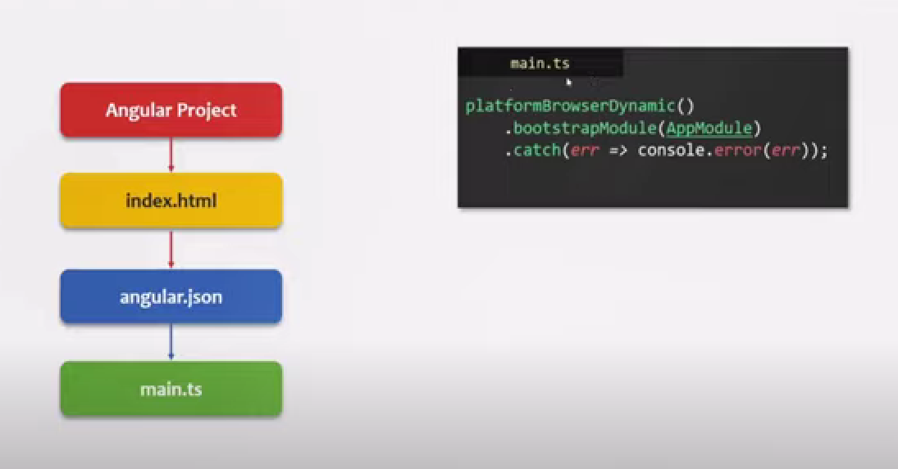
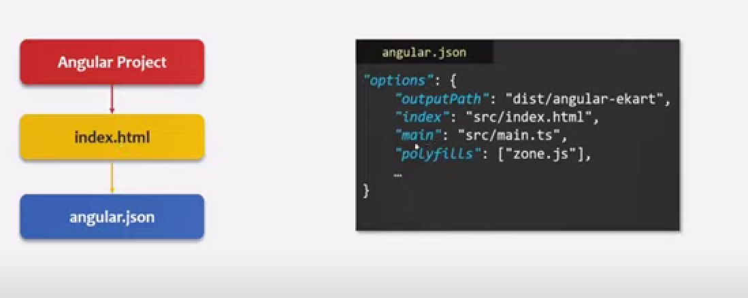

Slide 24
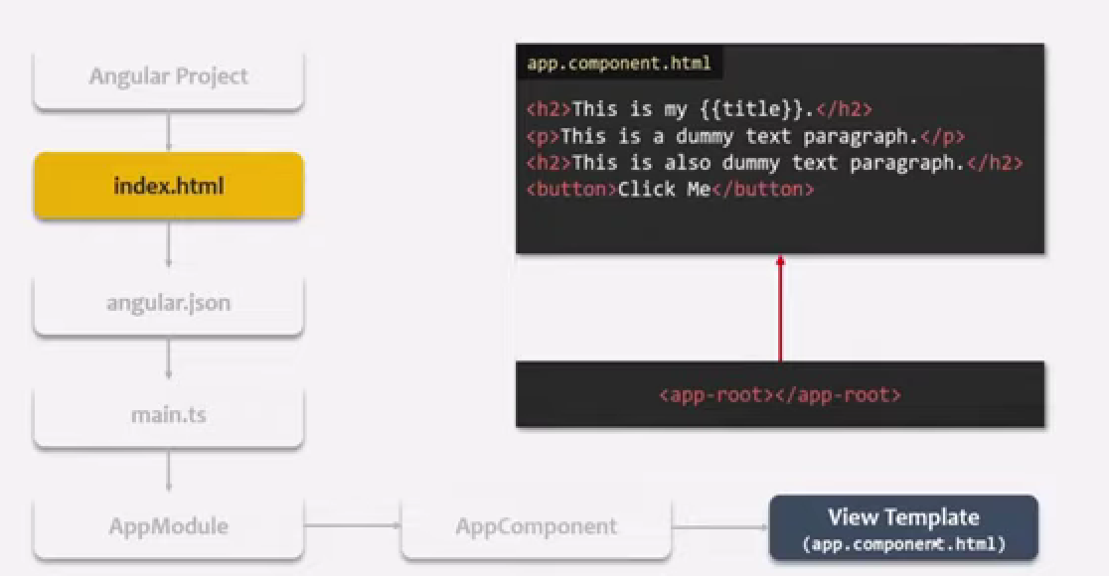
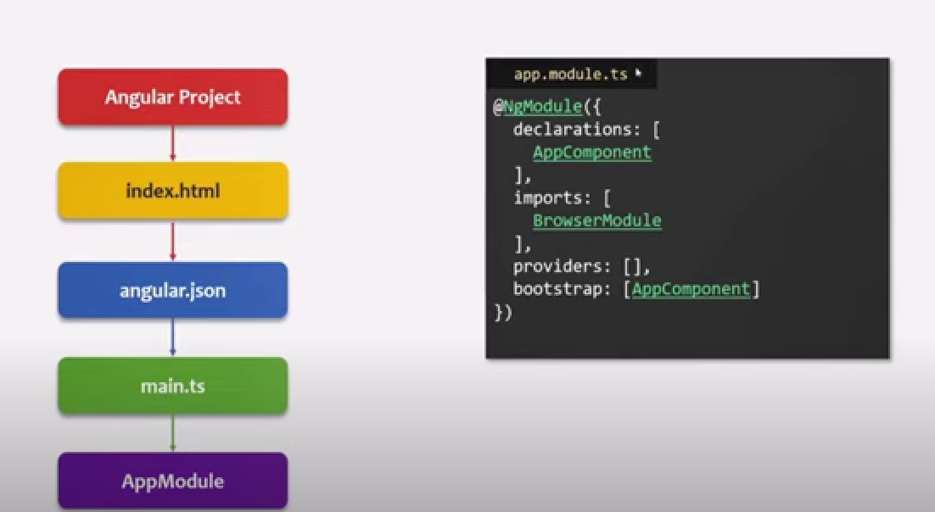
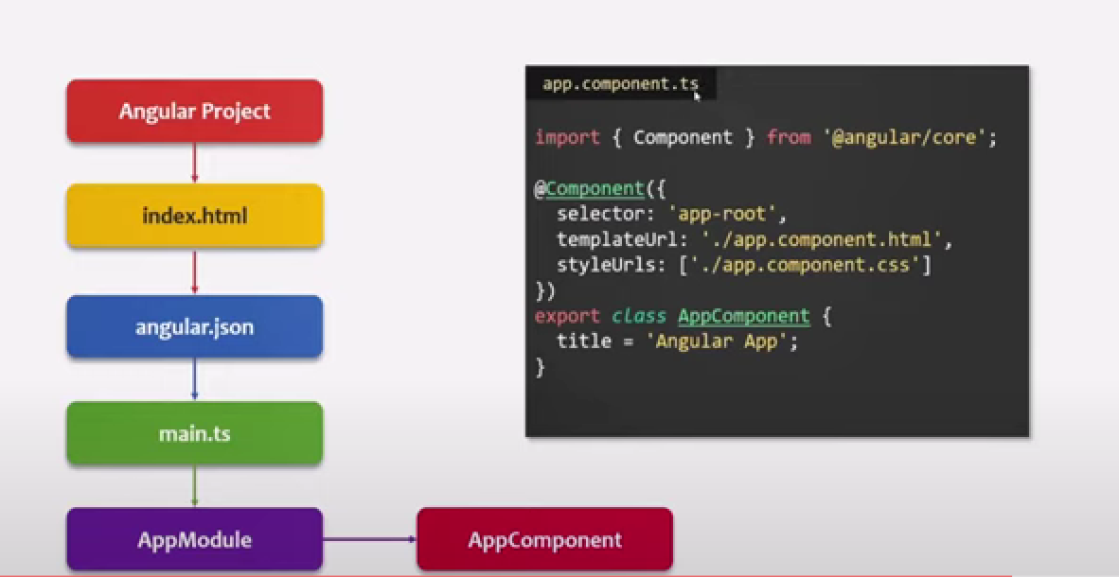

Slide 25
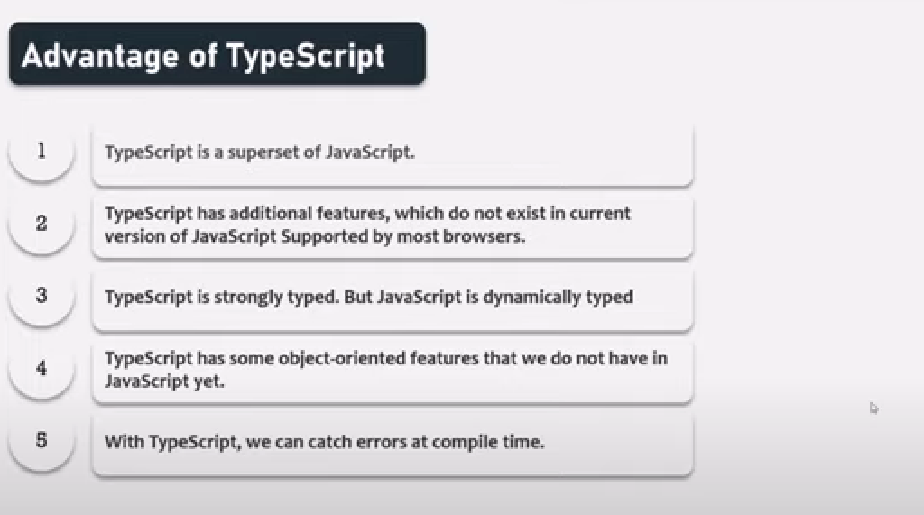



Slide 26


Slide 27


Slide 28
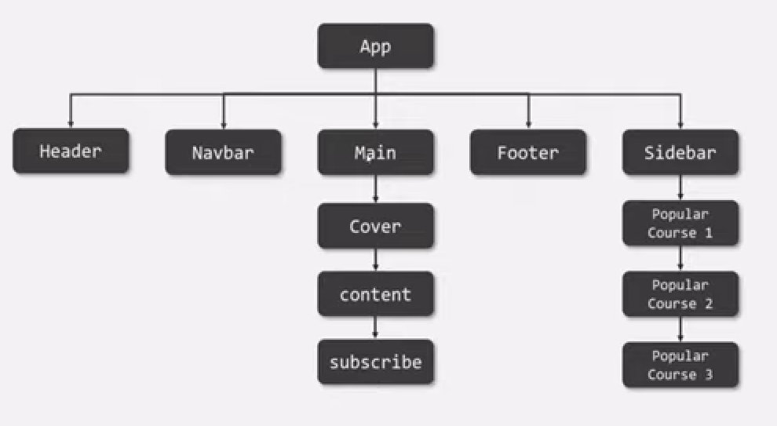
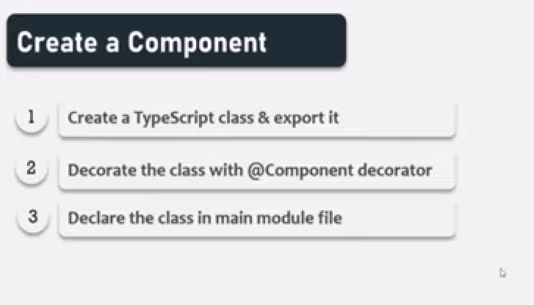

Slide 29



Slide 30
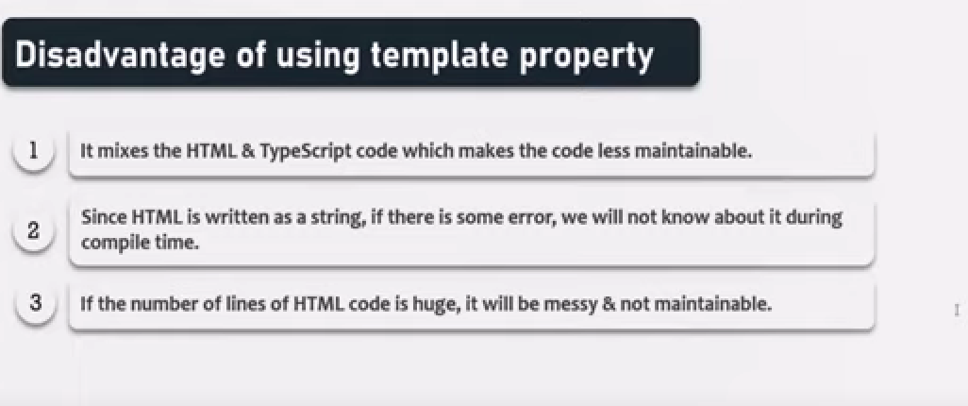

Slide 31


Slide 32
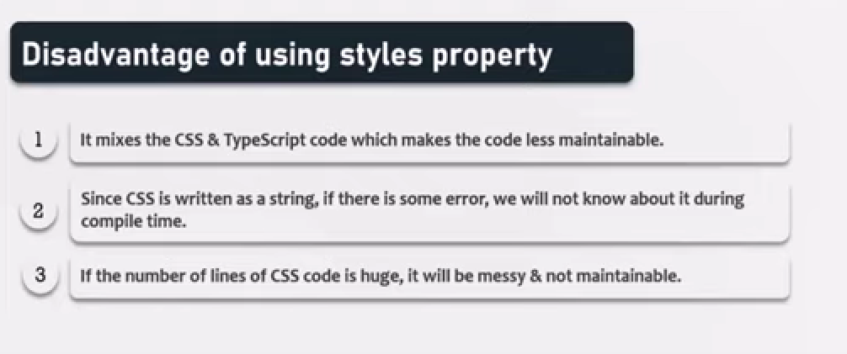

Slide 33

Add CSS in Style.css class to apply globally

Slide 34

npm install –save bootstrap
Check bootstrap installed correctly under node_modules/bootstrap/dist/css/bootstrap.min.css
Add path in angular.json file in styles array (or)
Import bootstrap in Style.css file (@import ‘~bootstrap/dist/css/bootstrap.min.css’;)

Slide 35



Slide 36

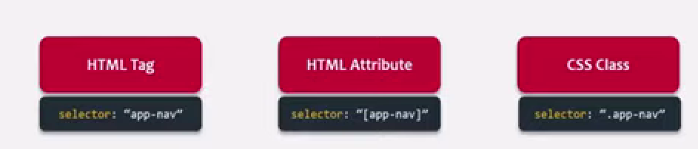

Slide 37


Slide 38
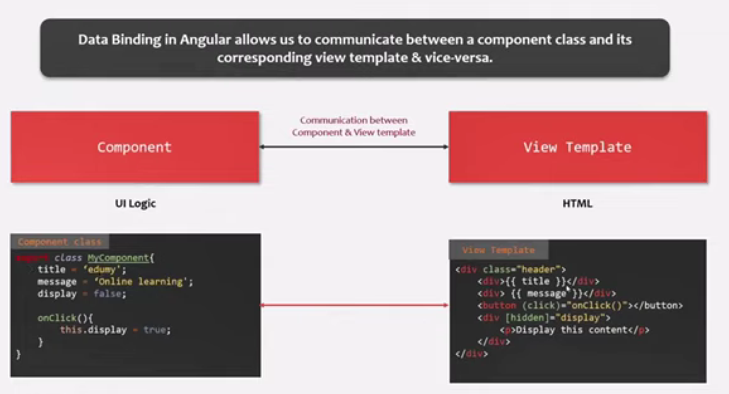


Slide 39
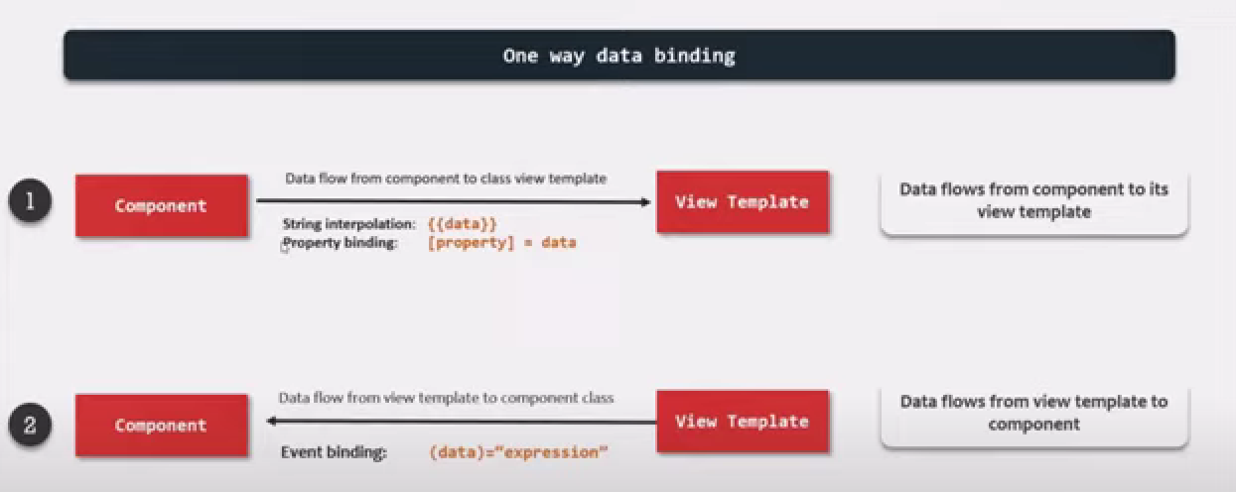

Slide 40
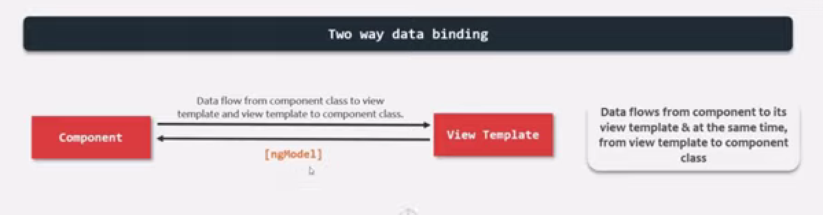

Slide 41

{{}}

Slide 42

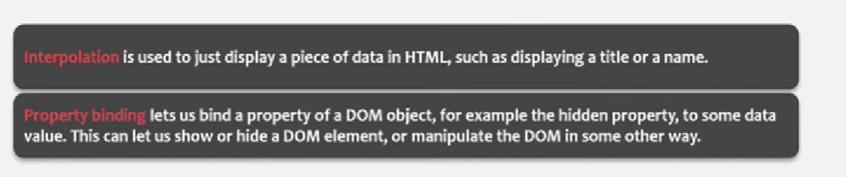

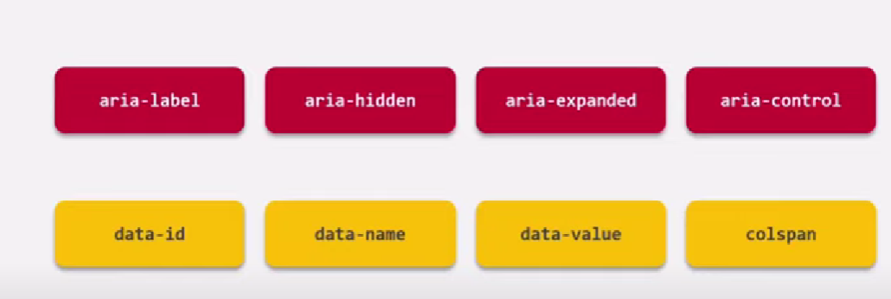
[Html attribute]=“typescript”

Slide 43

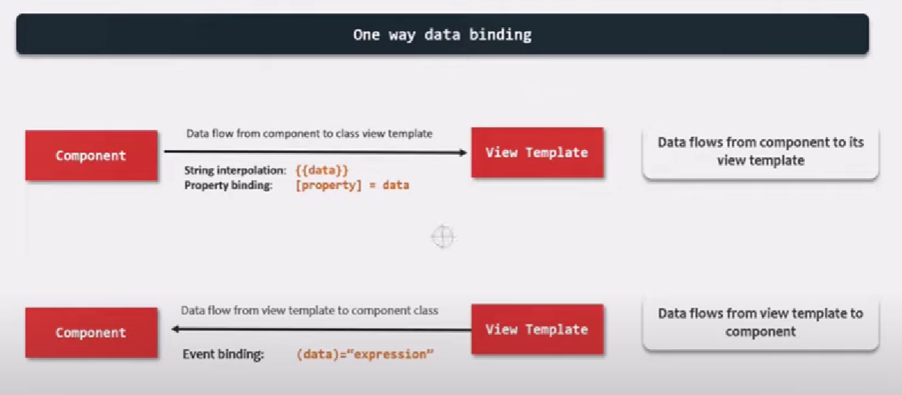

Slide 44


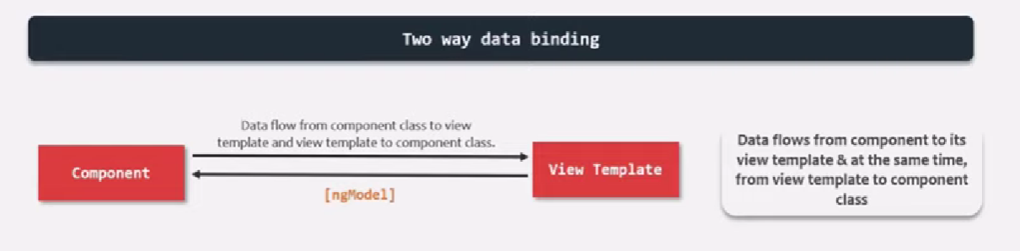

Slide 45



Slide 46
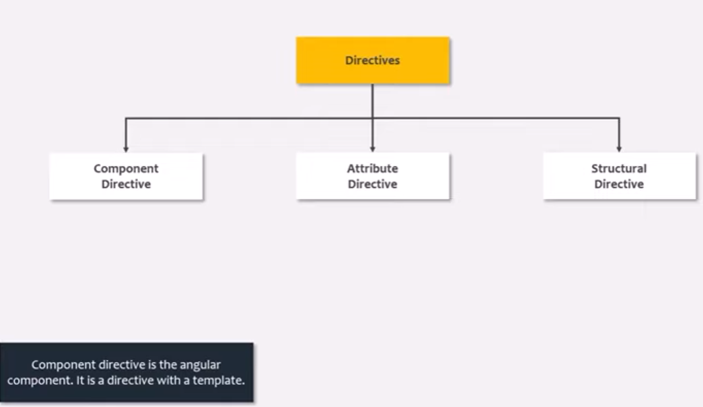

Slide 47
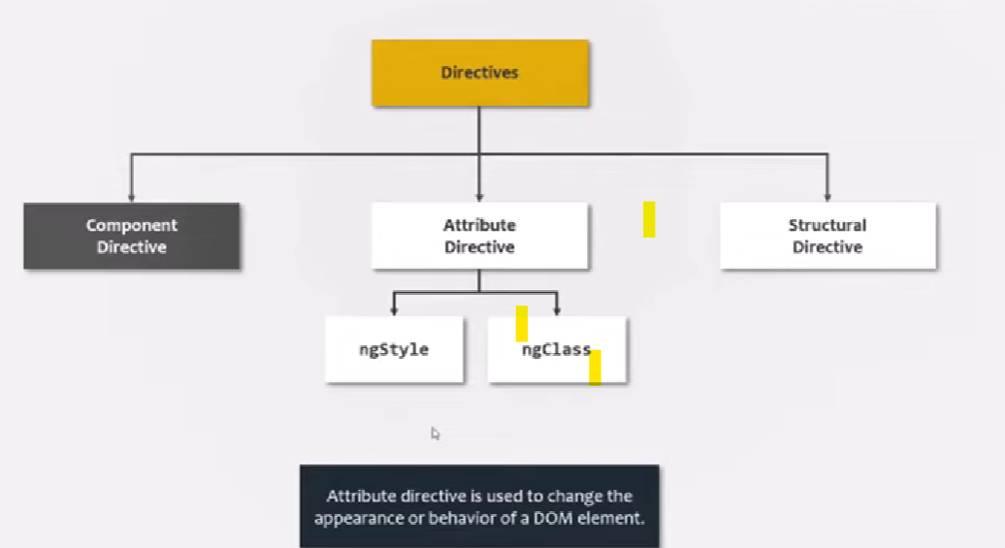

Slide 48

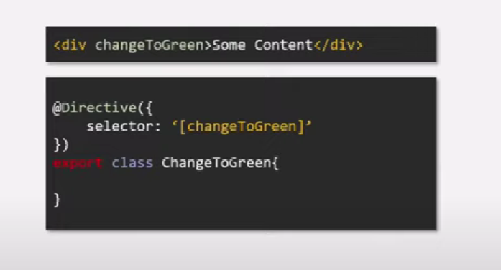

Slide 49

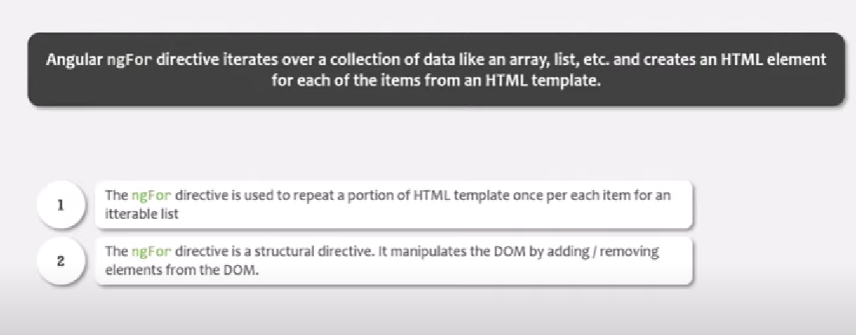

Slide 50


Slide 51


Slide 52
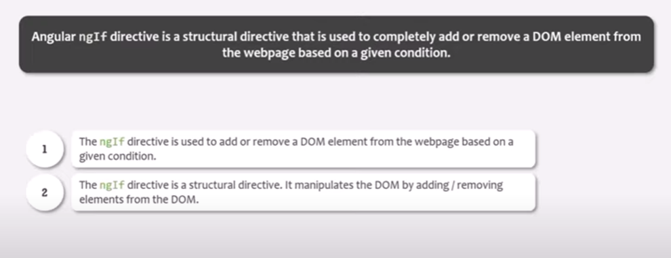

Slide 53


Slide 54
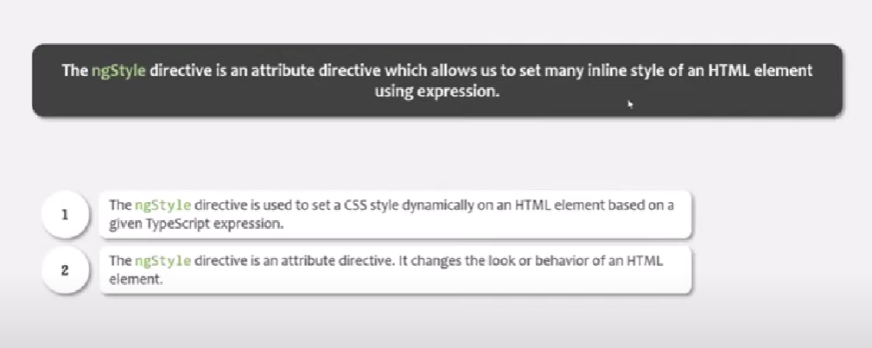

Slide 55


Slide 56
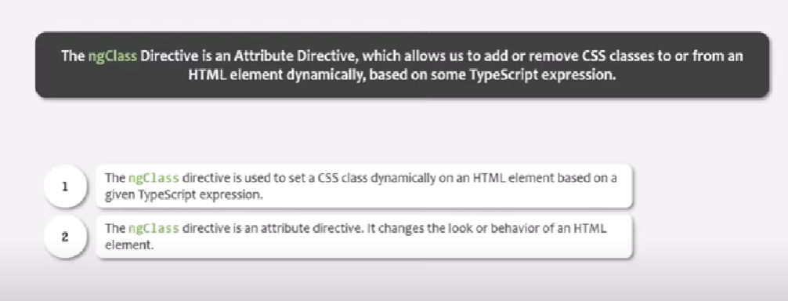

Slide 57


Slide 58
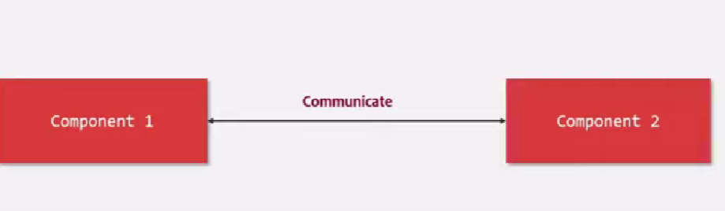
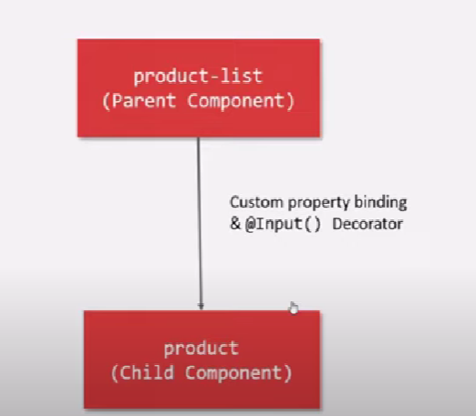

Slide 59
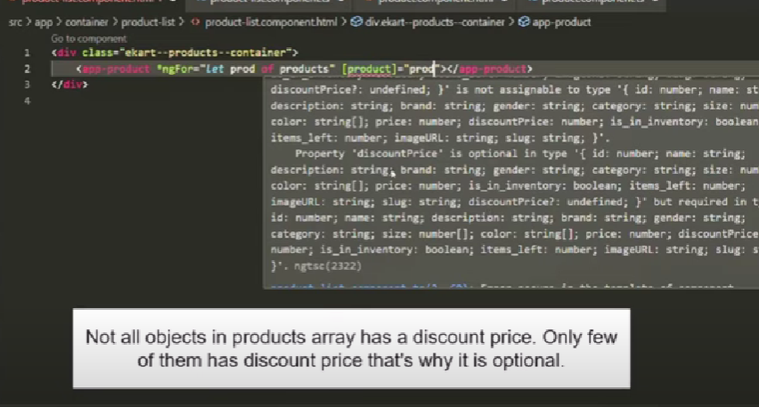

Slide 60
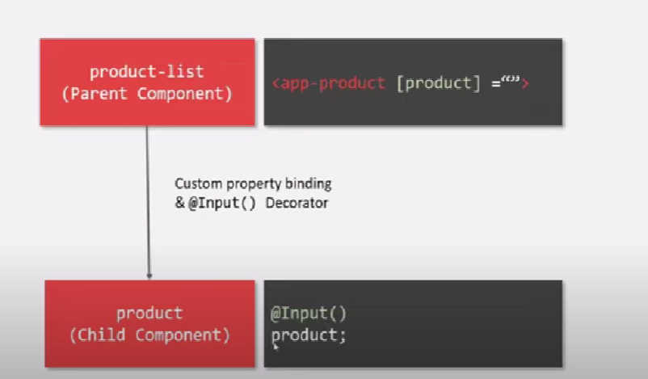

Slide 61



Slide 62
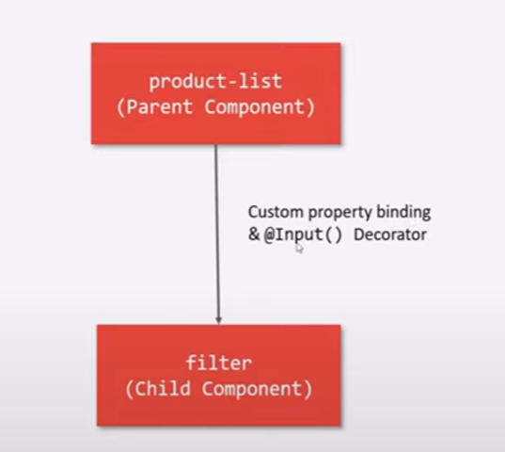
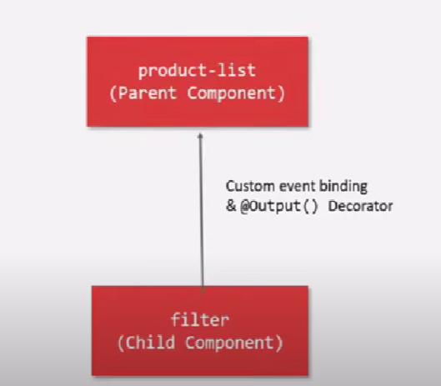


Slide 63
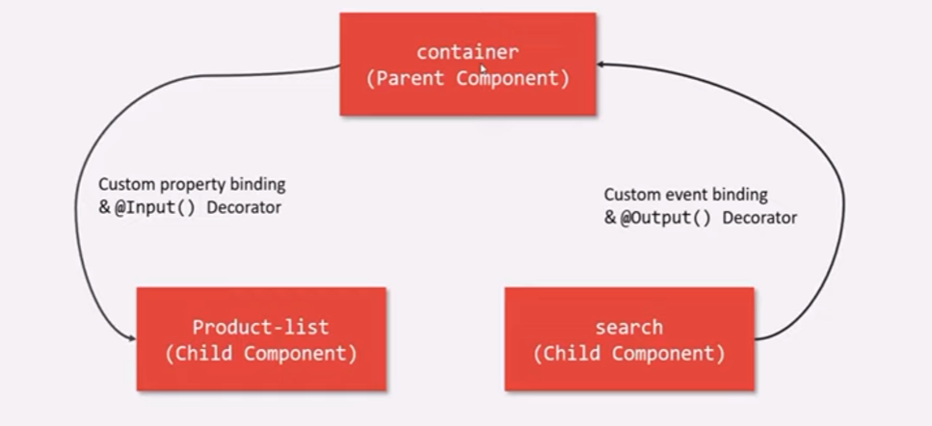


Slide 64



Slide 65


Slide 66



Slide 67
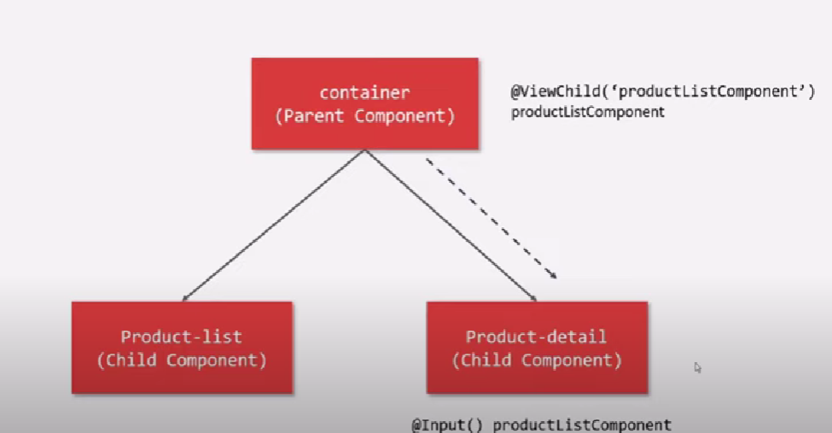

Slide 68



Slide 69
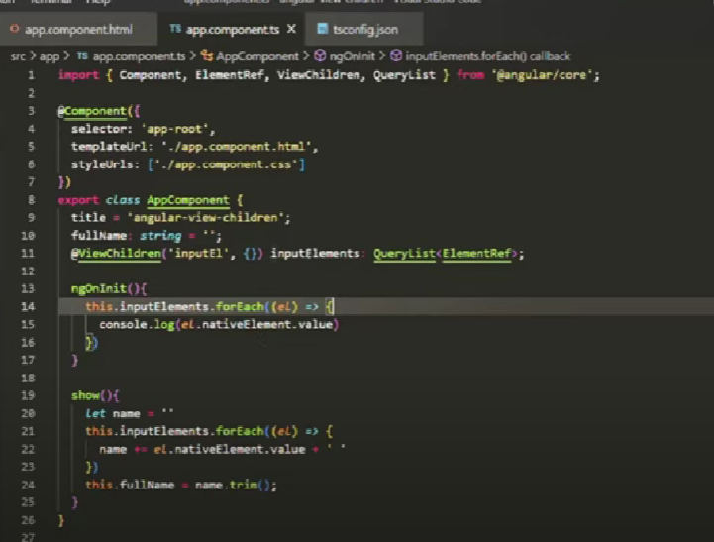
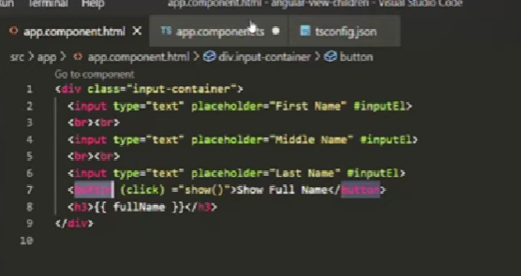

Slide 70



Slide 71

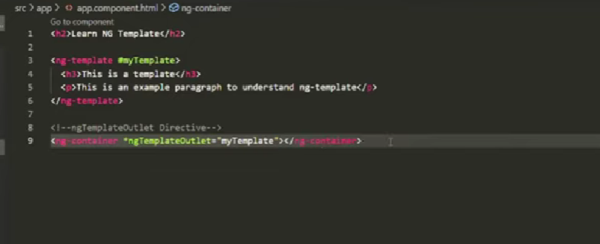


Slide 72


Slide 73



Slide 74
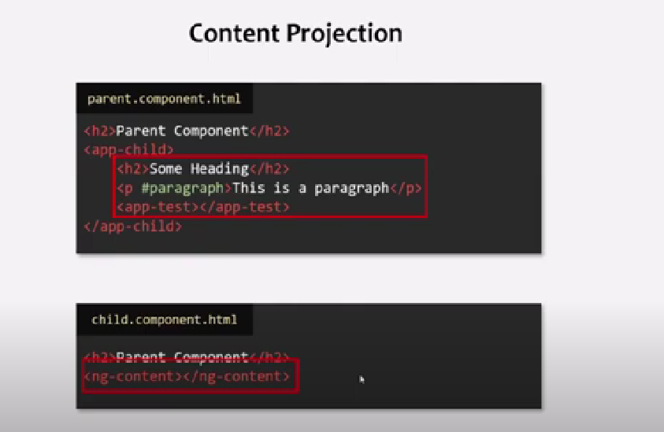
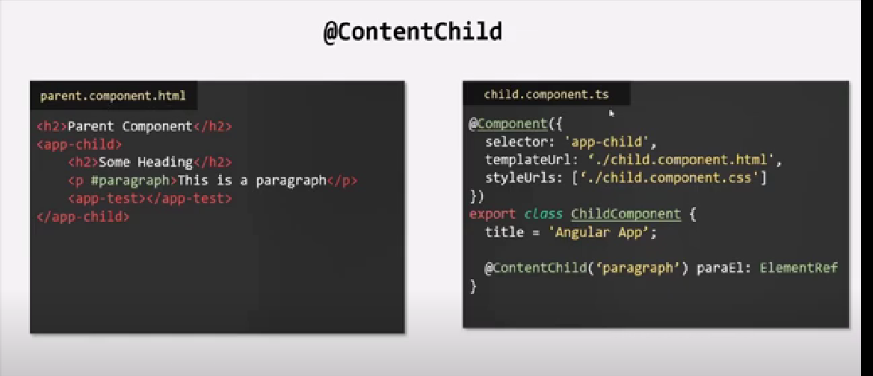

Slide 75



Slide 76
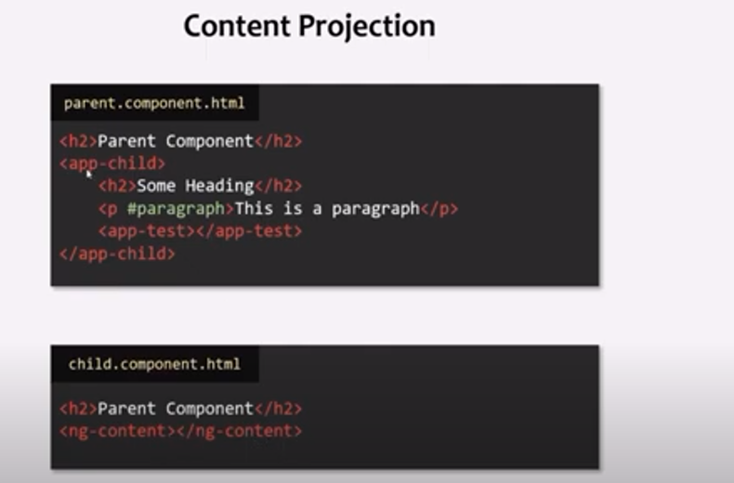

Slide 77
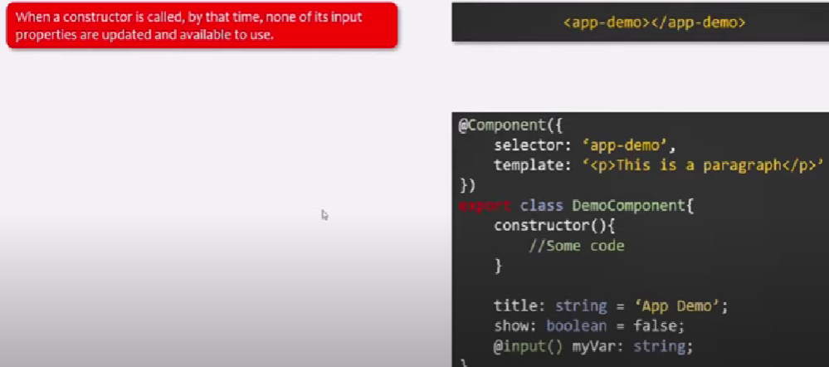


Slide 78



Slide 79



Slide 80



Slide 81


Slide 82



Slide 83



Slide 84



Slide 85


Slide 86



Slide 87



Slide 88



Slide 89



Slide 90



Slide 91




Slide 92



Slide 93



Slide 94


Slide 95


Slide 96


Slide 97


Slide 98



Slide 99



Slide 100



Slide 101



Slide 102



Slide 103




Slide 104


Slide 105



Slide 106


Slide 107



Slide 108


Slide 109




Slide 110


